Slide 1
URL Based Phishing Detection using Machine Learning
Submitted to:
Dr. Neha Gahlan

Slide 2
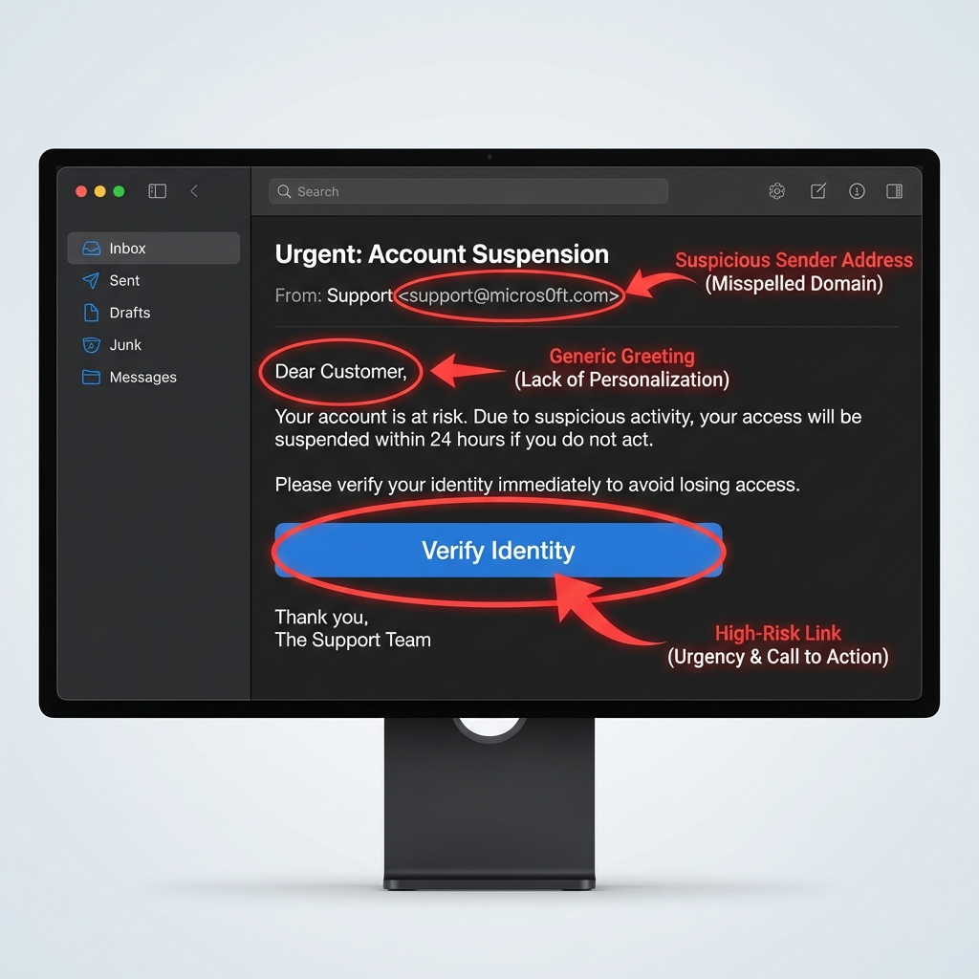

Why URL based Phishing Software is needed?
Malicious URLs have become the primary attack vector for distributing malware and stealing credentials. With explosive growth in digital banking, e-commerce, and cloud services, users face increasingly sophisticated phishing websites that closely mimic legitimate ones
Impact: Organizations face financial losses, data breaches, compromised user trust, and regulatory penalties. Individuals risk identity theft and unauthorized account access.

Slide 3
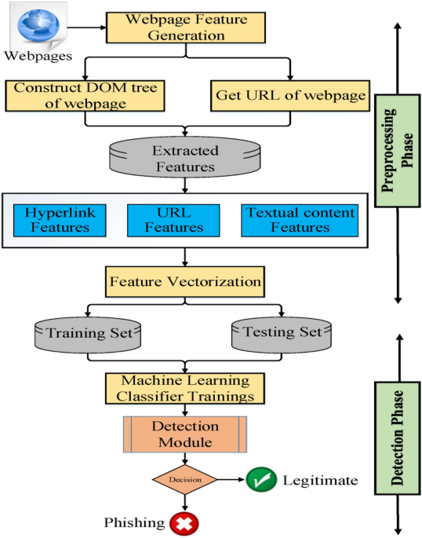
Architecture Flow
An intelligent, automated system that analyzes URLs and classifies them as safe or unsafe before users interact with them. This project implements such a system using Python (backend), UI Development using Gradio, integrating machine learning models for real-time threat detection.
Core Technology used:
System Flow
Python 3.x
pandas
NumPy
tldextract
scikit-learn
matplotlib
Seaborn
Gradio
Input URL is collected
Feature vectorization is applied
Data is split into training and testing
Model is trained using training data
Detection module processes new input
Final decision

Slide 4

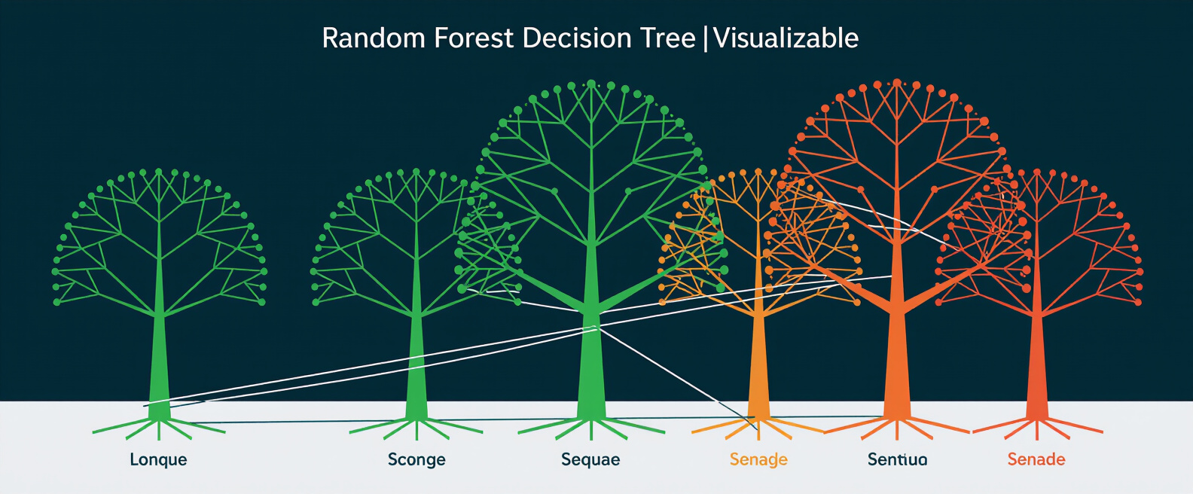
Algorithm & Development Overview
Model Performance Comparison
Logistic Regression
Random Forest Classifier
Logistic Regression — Training: 92.7% | Test: 93.4%
Random Forest — Training: 99.1% | Test: 96.0% | Alternative: 96.7%
A linear classification algorithm that models the probability of a URL being malicious based on extracted features. Provides interpretable results and fast predictions.
An ensemble method combining multiple decision trees to improve accuracy and robustness. Captures complex feature interactions and reduces overfitting risk.

Slide 5
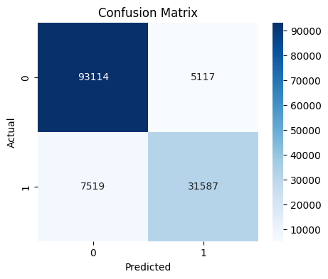
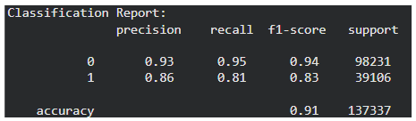
Model comparison - Confusion matrix
Performance Evaluation
Visualization
Precision recall F1 metrics
Class-wise model performance
High overall accuracy (~91%)
Balanced prediction quality
Confusion matrix overview
Correct vs incorrect predictions
Diagonal shows accuracy
Errors shown off-diagonal

Slide 6


Data Preparation Pipeline
Data Preprocessing
Feature Extraction from URLs
Data Splitting
Renamed dataset columns for consistency
Converted labels into numeric format
Removed missing/null values
Prepared data for feature extraction
Extracted important characteristics from URLs such as:
URL length
Number of dots, hyphens, special symbols
Presence of IP address
HTTP/HTTPS usage
Domain, subdomain, and TLD length
These features help identify suspicious patterns
Dataset divided into:
Training Set (75%)
Testing Set (25%)
Stratified sampling used to maintain class balance
Ensures fair model evaluation

Slide 7
Building & Evaluating the Model
Model Selection
Model Training
Performance Evaluation
Logistic Regression
Simple and fast baseline model
Random Forest
Ensemble model with multiple decision trees
Provides higher accuracy and robustness
Models trained using extracted features
Learned patterns between phishing and legitimate URLs
Random Forest showed better performance
Evaluated using:
Accuracy Score
Classification Report (Precision, Recall, F1-score)
Confusion Matrix
Helps measure prediction quality

Slide 8
Team Contribution
S.N | Name | Contribution
1 | Swati Sisodia | Python library Dataset & Problem Understanding Visualizations: Confusion Matrix
2 | Ashis Ancy | URL Feature Extraction Techniques Suspicious Pattern Identification Domain & Structural Feature Analysis
3 | Asif Salim | Model Selection Strategy Training using Logistic Regression Training using Random Forest
4 | Sohel Maharjan | Architecture Diagram Model Comparison & Optimization Development lifecycle (Frontend/Backend) UI Development using Gradio

Slide 9
Conclusion: Advancing Phishing Detection — Intelligent automation transforms cybersecurity defense—protecting users from evolving threats while maintaining seamless digital experiences.

